Slide 1
SIS 2020 Football Analytics Challenge
Matt Pallini
mattpallini@gmail.com

Slide 2
Assumptions - Metric
Metric used in the analysis is defensive expected points added
dEPA = EPA * -1
Since this analysis looks at the value of defensive line positions, the EPA is adjusted to show value to the defensive team
dEPA can then be used to show the EPA for each DL position on a per play average
dEPA for a given play is allocated to each player on the DL
dEPA per play figures are based on 60 plays
That is roughly the average number of defensive snaps per team in the data

Slide 3
Assumptions – Player Positions
Player positions are defined by the technique used on a given play
Four (4) position types are analyzed:
Nose tackle (NT)
Defensive tackle (DT)
Defensive end (DE)
EDGE
Position Name | Techniques
NT | 0, 1
DT | 2, 2i, 3
DE | 4, 4i, 5, 7
EDGE | 6, 9, Outside, Off Ball

Slide 4
Which is the most valuable DL position?

Slide 5
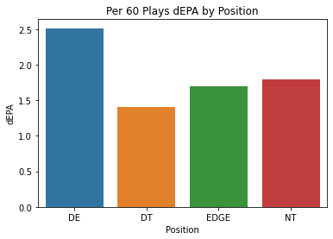
Most Valuable DL Position
On a per play basis DE is the most valuable position on the defensive line
This position group produces significantly more on each play than any other position

Slide 6
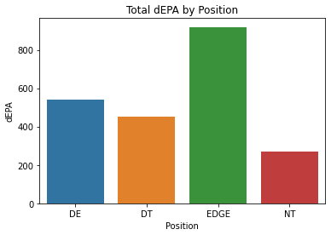
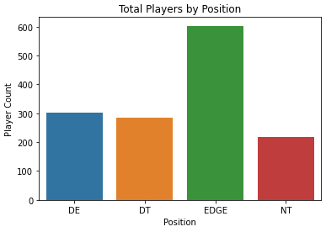
Most Valuable DL Position
However, the versatility of EDGE players make them very valuable compared to other positions
The EDGE produced 378 more total dEPA compared to the DE position
Any player on the defense can line up in an EDGE position, which creates confusion for the offense
There are nearly double the number of EDGE players in the data than any other position

Slide 7
What is the play distribution between positions?

Slide 8
Play Distribution
EDGE rushers produce the most statistically in aggregate
Position | dEPA | Solo Sack | Assisted Sack | Pressure | Pass Breakup | Forced Fumble
DE | 541 | 78 | 21 | 688 | 28 | 17
DT | 452 | 92 | 14 | 701 | 57 | 8
EDGE | 919 | 291 | 54 | 2020 | 112 | 74
NT | 269 | 26 | 15 | 278 | 18 | 5

Slide 9
Play Distribution
DE players produce more dEPA on a per 60 play basis than other positions
EDGE players produce more pass rushing and “disruption” stats on a per 60 play basis
Position | dEPA | Solo Sack | Assisted Sack | Pressure | Pass Breakup | Forced Fumble
DE | 2.51 | 0.36 | 0.10 | 3.20 | 0.13 | 0.79
DT | 1.40 | 0.28 | 0.04 | 2.17 | 0.18 | 0.25
EDGE | 1.69 | 0.54 | 0.10 | 3.72 | 0.21 | 0.14
NT | 1.79 | 0.17 | 0.10 | 1.85 | 0.12 | 0.03
*Figures based on per 60 plays

Slide 10
How does value change based on game situations?

Slide 11
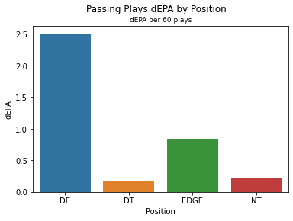
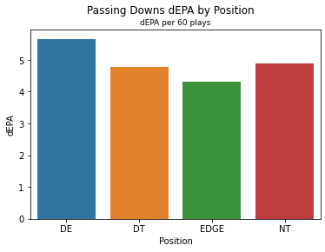
Passing Plays
All Passes
Likely Passing Downs
DE players produce the most on all pass plays
1st and 15 or greater
2nd and 10 or greater
3rd / 4th and 5 or greater
Edge players produce the least

Slide 12
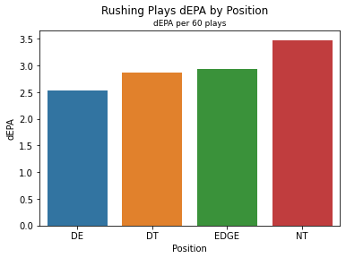
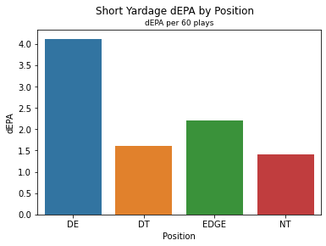
Rushing Plays
All Rushes
Short Yardage Downs
DE players produce the least per play on all rushing plays
3 yards or less to go
DE produce the most on short yardage

Slide 13
Conclusions and Next STeps

Slide 14
Conclusions
On a per play basis, DE is the most valuable position on the defensive line
DEs produce at a consistently high level during all game situations
While DEs produce better on average, their position assignments limit teams to having only 1 or 2 on the field at one time
EDGE players are able to move all over the formation, allowing any player to have an EDGE assignment on a given play
EDGE players produce more in aggregate due to this versatility

Slide 15
Next Steps
This analysis could be expanded upon if the offensive formation information was also available
Defenses focus on matching up correctly to the formation the offense has on the field
Understanding how different DL positions and combinations produce against a spread or heavy formations would provide additional value
Obtaining more data to analysis this metrics over a longer period of time
Gaining a better understanding of the offensive play design
On run plays specifically, it would be helpful to know if the play used a zone running scheme or designed cutback
This could explain if the UsedDesignGap is 0, whether that was by design or if the defensive line was effective in disrupting the original play

